Slide 1
Using MVC frameworks
Notes:
[Mandatory Slide] This would be the introduction slide of the topic that you are covering in this subsection.
When this slide plays, you could talk about the main aim that we’d be covering in this video.

Slide 2
In this Video, we are going to take a look at…
What is a web framework?
Features of web frameworks
What is MVC?
Notes:
[Mandatory Slide]
Before the start of the video, we’d like to highlight what are important topics or pointers that we’d be covering in this video. This slide would immediately follow the intro/name slide. This would just be say 2-3 points for the viewers to know what they are getting into.

Slide 3
What is a web framework?
A web framework is a software library designed to support the development of web applications, web sites and web APIs. The main point in using a web framework is increasing productivity (Don’t Repeat Yourself!)
Web frameworks solve issues like the following ones:
Mapping requested URLs to the server-side code that is meant handle them
Return dynamically generated HTML pages
Design HTML page templates before or along the web app code is written
Authenticate the users trying to access a web application
...
Notes:
[Mandatory Slide]
Before the start of the video, we’d like to highlight what are important topics or pointers that we’d be covering in this video. This slide would immediately follow the intro/name slide. This would just be say 2-3 points for the viewers to know what they are getting into.

Slide 4
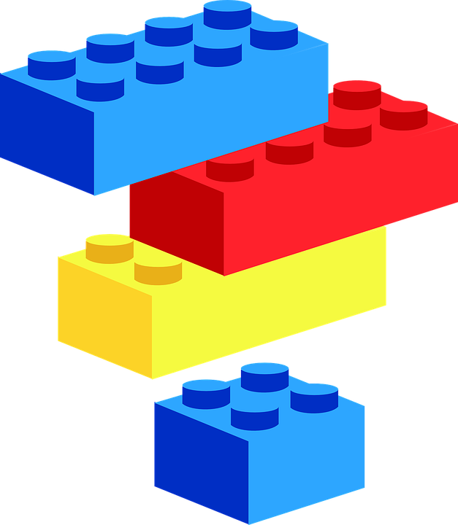
Features of a web framework
These are the typical features of web frameworks:
HTTP Requests/Responses are software objects
User authentication and authorization
URL routing
Templating engine
Object-Relational Mappers
Support to database migrations and versioning
Development web server
Logging
Command-line management utilities
… and structural Model-View-Control support
Notes:
[Mandatory Slide]
Before the start of the video, we’d like to highlight what are important topics or pointers that we’d be covering in this video. This slide would immediately follow the intro/name slide. This would just be say 2-3 points for the viewers to know what they are getting into.

Slide 5

What is MVC? (1/3)
Model-View-Control (MVC) is an architectural design pattern that can be applied to both server and client sides of a web application. It works like this:
Handles User Inputs and Renders the GUI Relays events to Control
VIEW
Updates the Model (or updates the View)
Updates the View when data change
CONTROL
MODEL
Notes:
[Mandatory Slide]
Before the start of the video, we’d like to highlight what are important topics or pointers that we’d be covering in this video. This slide would immediately follow the intro/name slide. This would just be say 2-3 points for the viewers to know what they are getting into.

Slide 6
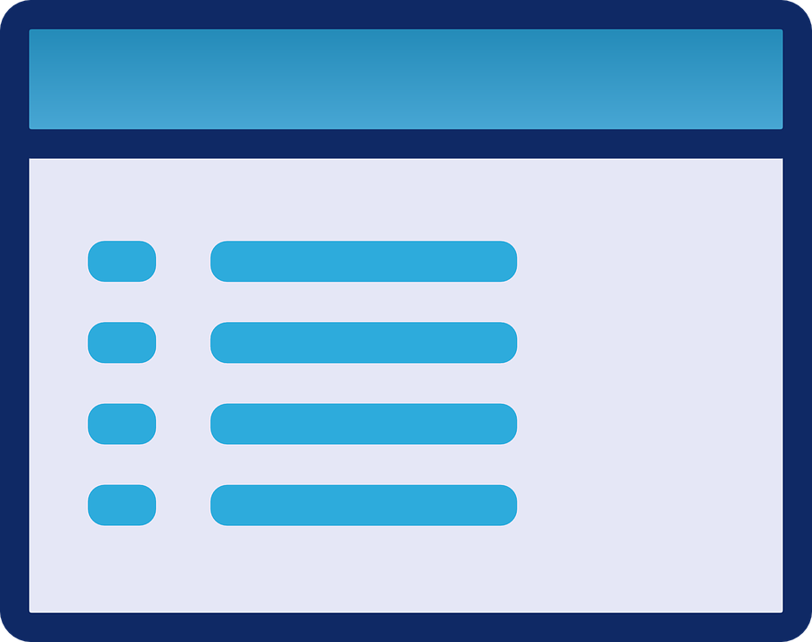

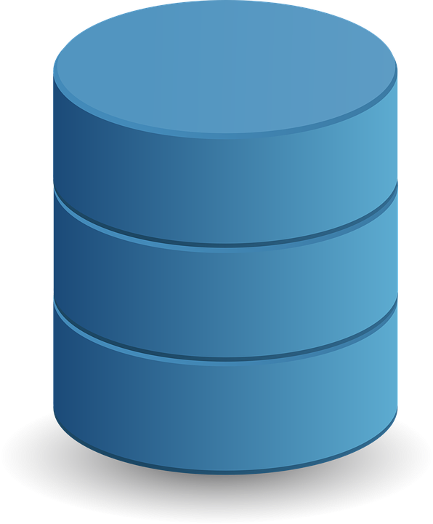
What is MVC? (2/3)
Example:
User submits a registration form
1
VIEW
4
A User Account HTML Template is filled with User’s data and the page is served
2
A Registration Controller is invoked
CONTROL
MODEL
3
Data is validated and a new User object is persisted
Notes:
[Mandatory Slide]
Before the start of the video, we’d like to highlight what are important topics or pointers that we’d be covering in this video. This slide would immediately follow the intro/name slide. This would just be say 2-3 points for the viewers to know what they are getting into.

Slide 7
What is MVC? (3/3)
MVC is modular by design and favours:
Separation of concerns
Web apps flexibility to modifications
Testability
Code reuse
Parallel Development
Swap in/out of technologies
Notes:
[Mandatory Slide]
Before the start of the video, we’d like to highlight what are important topics or pointers that we’d be covering in this video. This slide would immediately follow the intro/name slide. This would just be say 2-3 points for the viewers to know what they are getting into.

Slide 8
Summary
What is a web framework?
Features of web frameworks
What is MVC?
Notes:
[Mandatory Slide]
Before the start of the video, we’d like to highlight what are important topics or pointers that we’d be covering in this video. This slide would immediately follow the intro/name slide. This would just be say 2-3 points for the viewers to know what they are getting into.

Slide 9
Meet Flask and Django
Next Video
Notes:
[Mandatory Slide]
Here the name of the next video needs to be mentioned. The narration as you guessed it would be just letting the viewer know exactly where we are at and what we’d be taking over next! ☺

